Slide 1
Measuring the Deployment of IPv6: Topology, Routing, and Performance
Amogh Dhamdhere, Matthew Luckie, Bradley Huffaker, kc claffy (CAIDA / UC San Diego)
Ahmed Elmokashfi (Simula Research)
Emile Aben (RIPE NCC)

Slide 2
IPv6 Will Be Deployed Any Day Now
Amogh Dhamdhere, Matthew Luckie, Bradley Huffaker, kc claffy (CAIDA / UC San Diego)
Ahmed Elmokashfi (Simula Research)
Emile Aben (RIPE NCC)

Slide 3
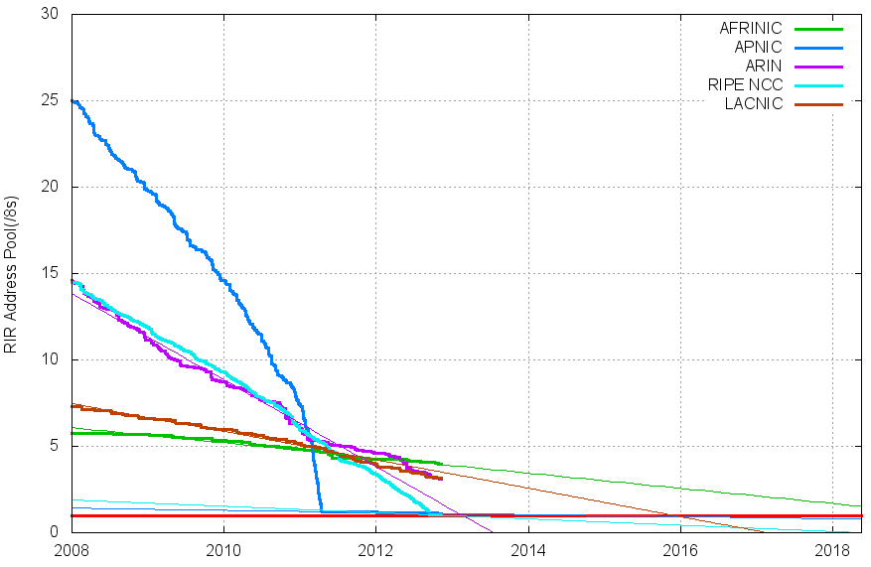
When will we run out of IPv4 addresses?
IANA runout
IANA ran out of IPv4 addresses in 2011
Regional Internet Registries (RIRs) are rationing but will soon run out too
Source: http://www.potaroo.net/tools/ipv4/index.html
3
Notes:
3

Slide 4
IPv6
4
Address run-out was anticipated back in the 1990s
IPv6 was standardized in the late 90s
Operating systems and network hardware have supported IPv6 for many years now
IPv6 provides much more address space than our foreseeable need

Slide 5
What’s the Problem?
5
Just use IPv6, right?
The issue: IPv6 is not backwards compatible with IPv4
Hosts with an IPv4 address cannot directly communicate with hosts with IPv6 addresses
IPv6 configuration, management and troubleshooting still not well understood

Slide 6
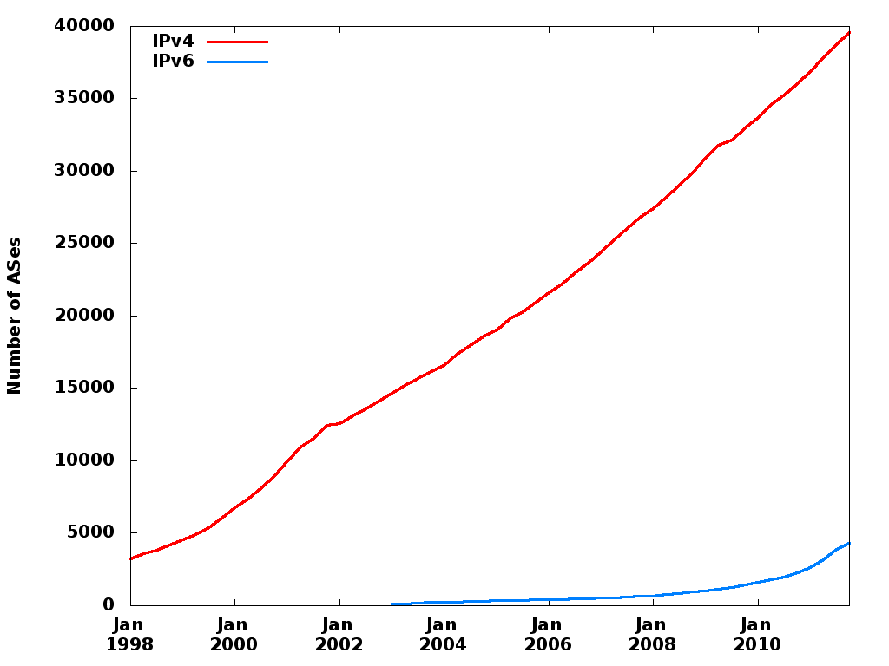
Growth of IPv[4|6]
IPv6 is here

Slide 7
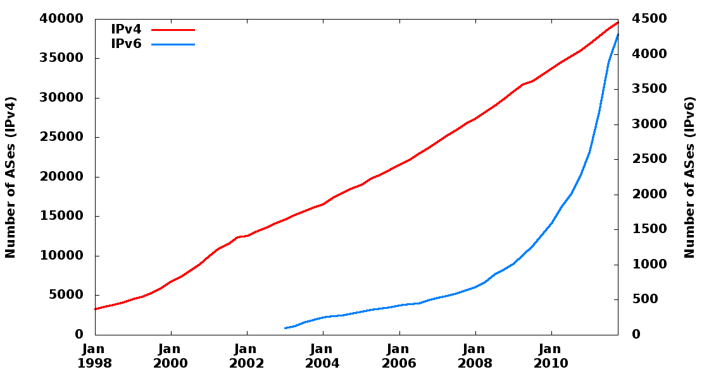
IPv6 growth: we need to zoom in..
Linear
Exponential
Exponential
The IPv6 topology grows exponentially while the IPv4 topology now grows linearly

Slide 8
Digging deeper
Exponential growth of IPv6 is encouraging
shift from a “toy” network to production?
Which geographical regions and network types contribute most of the growth?
Is the business mix in IPv6 converging to that in IPv4?
Is IPv6 performance comparable to IPv4 performance?

Slide 9
Measurement Data
Topology snapshots+updates from BGP routing datasets from 1998-present
Routeviews and RIPE
Annotated AS topology with business relationships on each link (Gao)
TODO: Integrate CAIDA’s algorithm (in process)
Annotated ASes with
Business types
Transit, Content/Access, Enterprise, etc
Geographical regions
ARIN, RIPE, APNIC
Web page downloads and AS paths to dual-stack webservers in Alexa 1M (performance)

Slide 10
AS Business Types
p2p
Large Transit Provider (LTP)
p2c
AT&T
Level3
$$$
Verizon
Small Transit Provider (STP)
$$$
Regional provider
Regional provider
Content/Access/Hosting Provider (CAHP)
$$$
$$$
$$$
$$$
UCSD
Rapidshare
Comcast
Georgia Tech
Enterprise Customer (EC)
A. Dhamdhere, C. Dovrolis. Twelve Years in the Evolution of the Internet Ecosystem. IEEE/ACM Transactions on Networking, vol. 19, no. 5

Slide 11
Key Results
IPv6 deployment is strong in core, lagging at edge
Performance is similar between IPv6 and IPv4
particularly with identical AS-level paths
< 50% of AS-level paths are identical
But could be much larger without deploying any new infrastructure
70% could be identical without establishing new peerings
>90% could be identical by establishing equivalent peerings amongst existing IPv6-deployed ASes
Path exploration / convergence delay in IPv4 and IPv6 has been the same since 2008

Slide 12
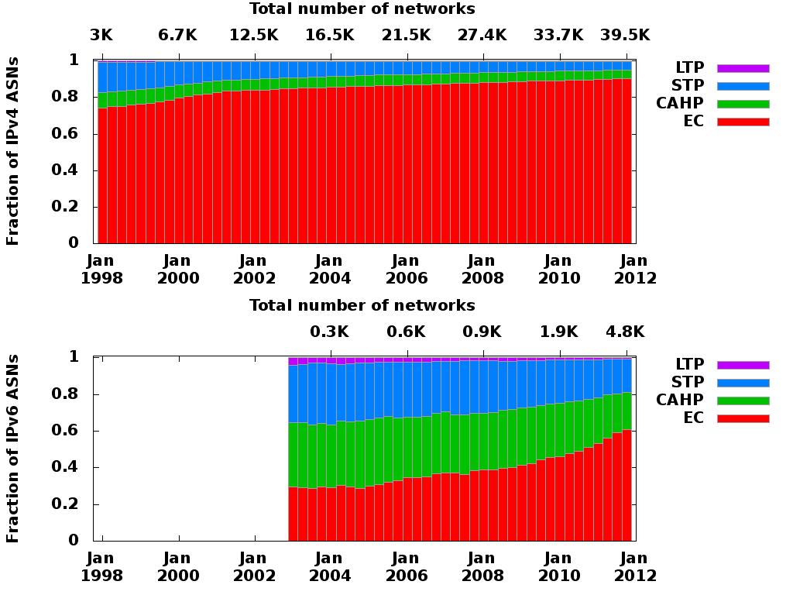
Evolution of the business mix
IPv4 network is dominated by ECs
Lower fraction of ECs in IPv6
Hypothesis: As IPv6 matures, the business mix should become similar to that in IPv4
IPv6 deployment at the edges is lagging

Slide 13
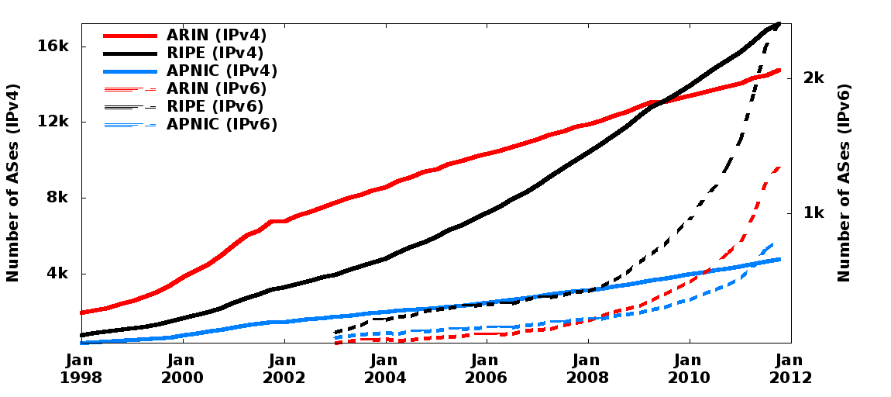
Growth trends by geographical region
IPv6: RIPE region was always ahead of ARIN
IPv4: More ASes in RIPE region than ARIN since 2009
The ARIN region is lagging in IPv6 deployment

Slide 14
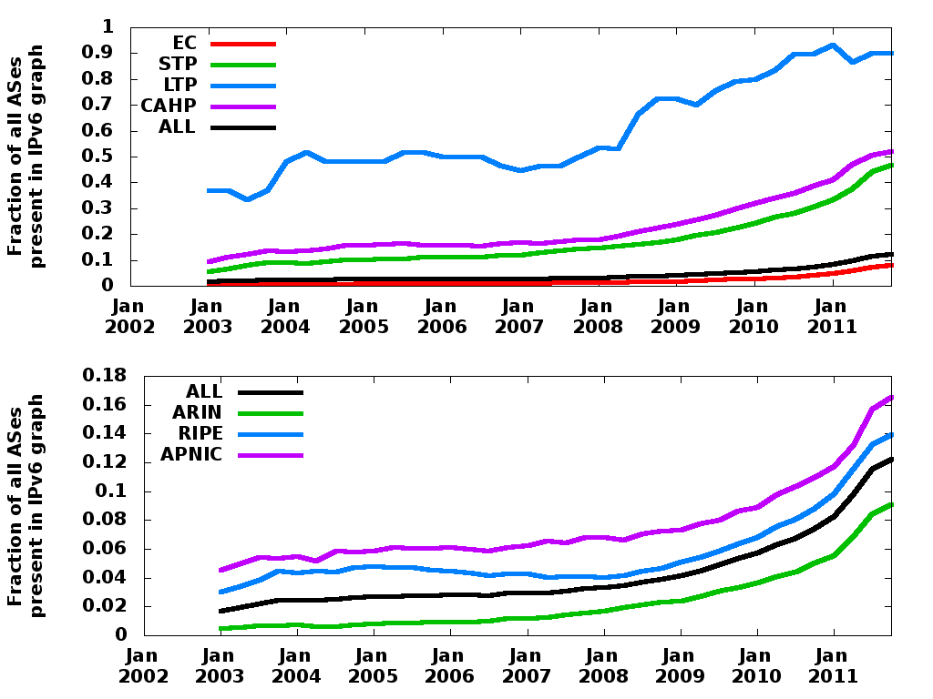
IPv4 and IPv6 topology convergence
Classification: business type
Classification:
geographical region
Transit providers and content providers are mostly present in the IPv6 graph, ECs are lagging
APNIC and RIPE lead ARIN in IPv6 presence
IPv6 convergence is not uniform across business types and geographical regions

Slide 15
Structure of AS-level paths
Hypothesis: As IPv6 matures, routing paths in IPv4 and IPv6 should become similar over time
Measured AS-level paths from 7 vantage points towards dual-stacked origin ASes
Focused on the fraction of identical IPv4 and IPv6 paths from each VP

Slide 16
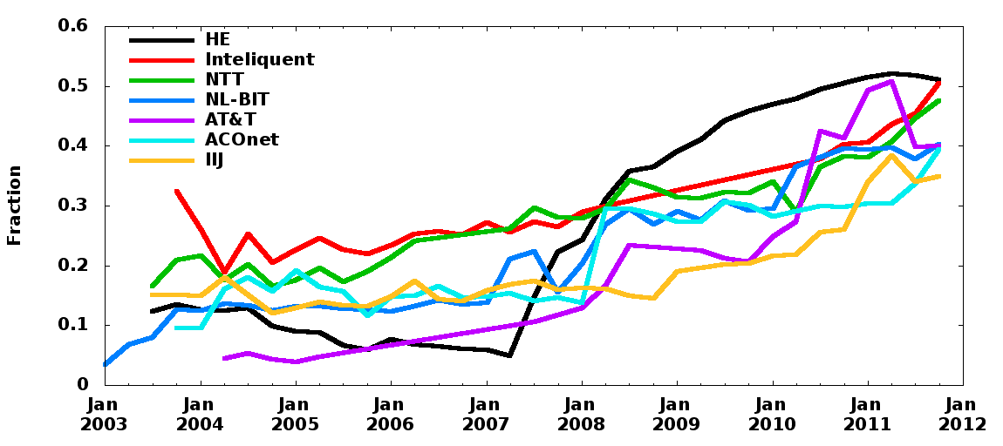
Identical AS-level paths
The fraction of identical paths is increasing
Currently less than 50% of IPv4 and IPv6 paths are identical
The IPv6 network is maturing, but slowly

Slide 17
Comparing IPv4 and IPv6 performance
Poor performance over IPv6 is likely to inhibit the adoption of IPv6
How often is performance over IPv6 similar to that over IPv4?
Measurements from 5 dual-stacked vantage points (CAIDA Ark) to dual-stacked websites
Webpage download times
AS paths to those websites (traceroute)

Slide 18
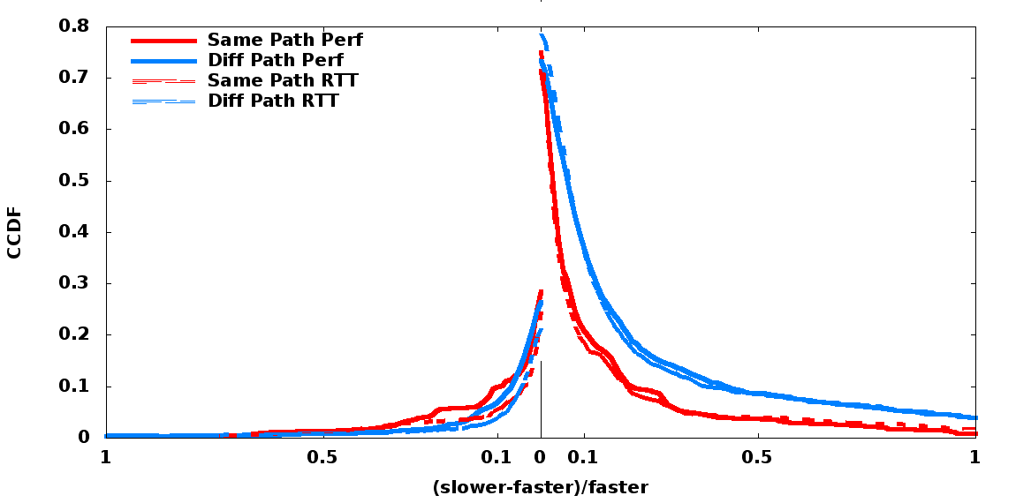
Performance: Webpage downloads
IPv6 faster
IPv4 faster
63%
79%
79% of paths had IPv6 performance within 10% of IPv4 when AS paths were the same
Only 63% of paths had similar performance when AS paths differed
Notes:
slide 17: fix red and green (pick different colors)
annotated with numbers
(are lines on other graphs this thick?)
label blue line with what it is
add bullet to slide 17 about not-topology-matching paths
Performance differences between IPv4 and IPv6:
AS paths same: 79% of paths perform within 10%
AS paths differ: 63% of paths perform within 10%
less than half of paths of the same -- OF OUR SAMPLE!! #s in sample
red and green are bad colors to use next to eachother
anyuthing but green is better

Slide 19
Relation between performance and AS-level paths
IPv6 performance is similar to IPv4 performance, if AS-level paths are the same
Key finding of Nikkhah et al.
< 50% of AS paths from dual-stacked vantage points are currently the same in IPv4 and IPv6
Increasing congruence between IPv4 and IPv6 topology will improve performance and thus deployment incentives
M. Nikkhah, R. Guerin, Y. Lee, R. Woundy. Assessing IPv6 through web access: a measurement study and its findings. CoNEXT 2011.
Notes:
----- Meeting Notes (7/10/12 15:42) -----
too much text
title: "relation between performance and AS-paths"
say this in fewer words or a graph

Slide 20
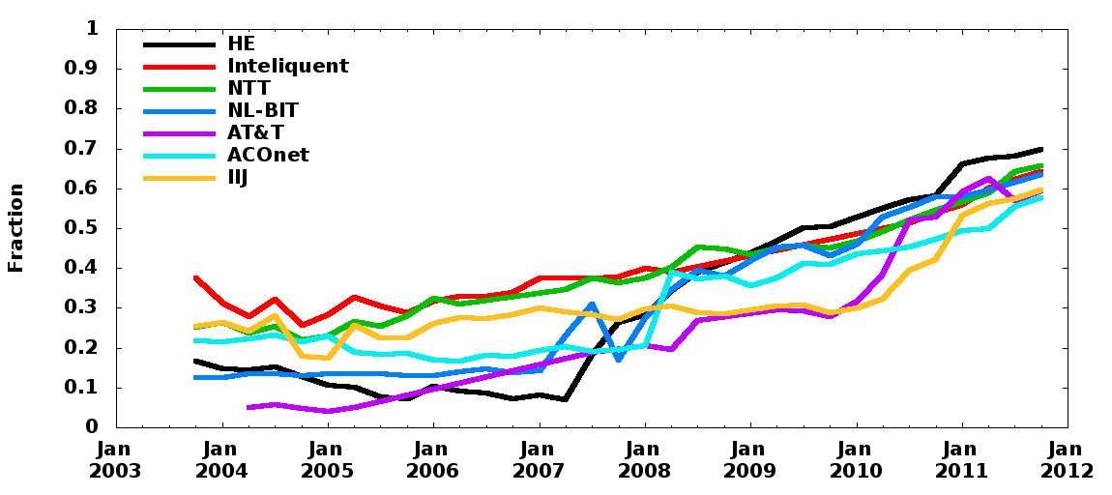
Potential AS-path congruence
For each link in an IPv4 AS path, is that link present in the IPv6 topology (anywhere)?
Based on links that already exist, up to 70% of paths could be identical (without building any new infrastructure)
Notes:
slide 19: retrofit this workding back into slide 10b

Slide 21
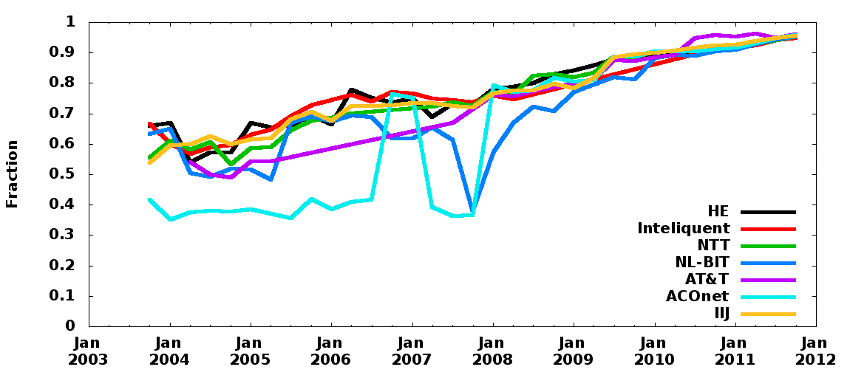
Potential AS-path congruence
For each AS in an IPv4 AS path, is that AS present in the IPv6 topology (anywhere)?
Based on ASes that are already in the IPv6 graph, more than 90% of paths could be identical
Notes:
slide 20: did you talk to nanog
message seems about operators
make list of who should peer with who --> blog

Slide 22
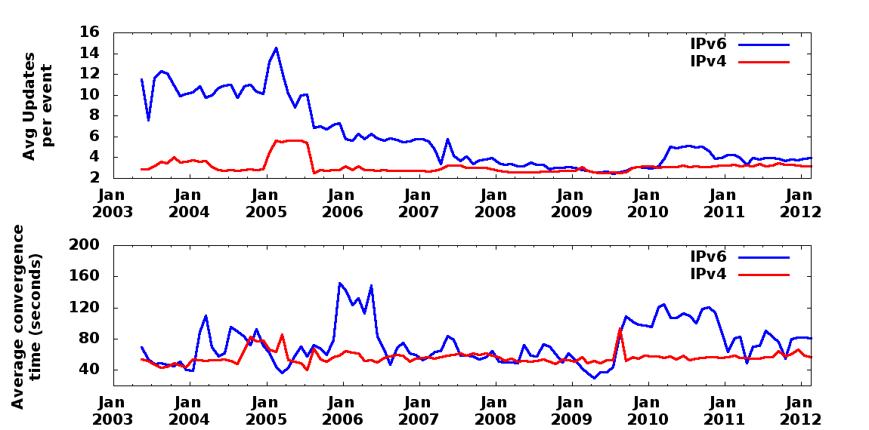
Routing Stability -- IIJ
Path exploration is similar in IPv4 and IPv6 since 2008
Time to convergence peaks in IPv6 are due to single prefix events -- convergence time is otherwise similar

Slide 23
Summary of findings
The IPv6 network is maturing…albeit slowly and non-uniformly
The “core” of the network (transit providers) are mostly doing well with IPv6 deployment
The edge (enterprises and access providers) is lagging
IPv6 deployment is faster in Europe and Asia-Pacific regions, North America is lagging
IPv4 and IPv6 paths could potentially be 90% similar, without deploying any additional infrastructure

Slide 24
Thanks! Questions?

